Slide 1
Off-Grid Communications with Android Meshing the Mobile World
November 2012

Slide 2


About Us
Homeland Security Systems Engineering and Development Institute (HS SEDI) is a not-for-profit federally funded research and development center (FFRDC) managed by The MITRE Corporation
SEDI supports the DHS by providing independent expertise in systems engineering and developing proof-of-concept prototypes
The Smart Phone Ad-Hoc Networking (SPAN) research project is funded by HS SEDI for use in emergency preparedness and response situations
MITRE: Jeff Robble, Oliver Chong, Sheldon Durrant, Nick Modly
Accuvant LABS: Josh Thomas
Notes:
POC: Proof of Concept
Critical Infrastructure Protection

Slide 3
Contact Info
Jeff Robble (stoker)
jrobble@mitre.org
mistr.stoker@gmail.com
Josh Thomas (m0nk)
jthomas@accuvant.com
m0nk.omg.pwnies@gmail.com

Slide 4

Open Source
SPAN is the collaborative effort of private, public, and independent contributors
Public release under GPLv3
GitHub repository: https://github.com/ProjectSPAN
Google Group: https://groups.google.com/forum/#!forum/spandev
Associated and leveraged projects
Wireless Tether for Root Users: http://code.google.com/p/android-wifi-tether/
Serval: http://www.servalproject.org/
Freifunk: http://start.freifunk.net/
OpenWRT: https://openwrt.org/
Commotion: https://code.commotionwireless.net/projects/commotion
tinc: http://www.tinc-vpn.org/
Notes:
Internal MITRE version focused on security

Slide 5




Motivation

Slide 6
Motivation
Hurricane Katrina, August 2005
Over 3,000,000 phone lines went down, 2000 cell towers knocked out
Land Mobile Radio (LMR) communications degraded
Ham radio operators assisted 911 dispatchers
Field reporters exchanged information between victims and authorities
Haiti earthquake, January 2010
Public telephone service and Digicel and Comcel cell networks went down
Haitel cell network quickly overloaded, partially by Red Cross volunteers
Fiber-optic networks disrupted
Tohoku earthquake, March 2011
Tsunami lead to Fukushima Daiichi Nuclear Power Plant meltdowns
Carriers forced to limit mobile phone traffic by 90-95%
Hurricane Sandy, October 2012

Slide 7
Motivation
Cell towers collapse, lose power, or quickly become overloaded
Landlines become disconnected from PSTN exchange offices
Public telephone network and Internet service loss
Cell towers, PSTN offices, wireless APs, etc. are single points of failure in a centrally managed communications infrastructure
These single points of failure all provide a convenient mechanism to sniff / filter user traffic and perform MITM attacks
Egyptian Arab Spring Protests, January 2011
Egyptian president Hosni Mubarak suddenly cuts off Internet and cell phone service
Notes:
PSTN: Public Switched Telephone Network
AP: Access Point
P2P: Peer to Peer
MITM: Man in the Middle

Slide 8
Motivation
Attacks on cellular communication are becoming more common
MITM attack launched against 4G and CDMA users at DEFCON 19
Commercialization of the IMSI catcher, a device used to spoof a cellular tower and intercept encrypted GSM traffic
A smart phone without a cell tower or wireless AP is more than a brick!
Although service providers might want you to think otherwise

Slide 9
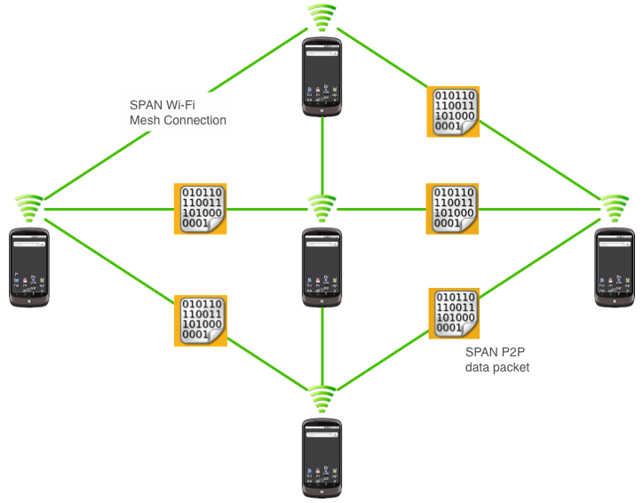
Solution

Slide 10
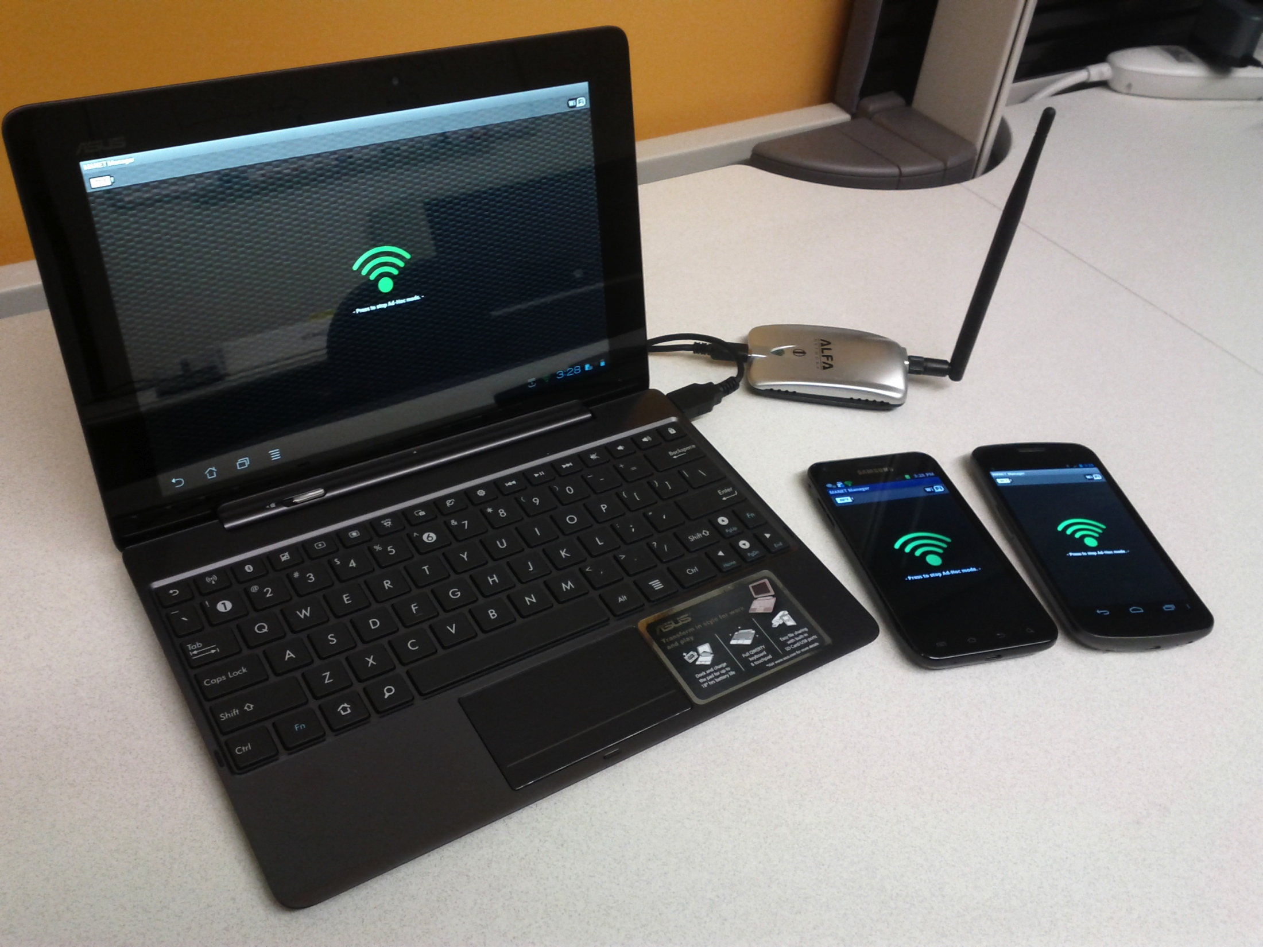
Solution

Slide 11
Solution
Leverage the ubiquity of smart phones to create a P2P mesh network
46% of American adults are smart phone users (up 11% from May 2011) [1]
Network is headless, does not depend on cell towers or wireless APs
Relay messages through peers, forming routing chains
Network dynamically expands as more peers join
Network is self-healing, peers can leave at any time
Share information across the Mobile Ad-Hoc Network (MANET) when infrastructure is broken or cannot be trusted
Form a P2P VPN over the mesh to secure communications
Route data through trusted peer devices
Nodes can act as gateway devices to connect the mesh to existing infrastructure as it becomes available
Share your cell phone service for your specific carrier
[1] http://pewinternet.org/Reports/2012/Smartphone-Update-2012/Findings.aspx
Notes:
Humans are routers

Slide 12
Potential FEMA Scenario
FEMA deploys Mobile Emergency Response Support (MERS) teams
Usually set up within 12 hours near airports
Location of MERS communication vehicles broadcast over AM/FM radio
Provide free public wifi and an IP voice gateway
Each MERS vehicle has a tower with 3 sector wifi antennas
MERS vehicles form a long-distance wireless mesh network
Extend mesh to mobile devices for FEMA, state, local, and public entities
Individuals set up initial mesh network immediately following or during the emergency situation
Broadcast SSID and other information over radio
Once MERS mesh network is deployed the range and robustness of the existing mesh is immediately enhanced without reconfiguration
Existing mesh users gain access to the Internet, VOIP gateway, information broadcasts, etc.
Notes:
MERS: Mobile Emergency Response Support set up usually near airports 12 hours after FEMA intervention
MERS provides an IP voice gateway, use to expand smart phone P2P VOIP
IMAT: Incident Management Assistance Team
IRCT: Incident Response Control Tream
FEMA IMAT, IRCT, and disaster response teams are first to deploy
Perform infrastructure assessments and take fly-away packs with LMRs
Location of MERS comm vehicles broadcast over FM/AM radio
Vehicles provide public wifi
PPD-8: Presidential Policy Directive 8: National Preparedness
SPAN most closely aligns with the response framework because it can be used to meet the immediate need for communication and information sharing during a natural disaster or terrorist event before traditional communication infrastructure can be fully recovered.

Slide 13



Potential FEMA Scenario
Downlink Internet
via satellite
3 Sector wifi
on all towers
Notes:
MERS: Mobile Emergency Response Support set up usually near airports 12 hours after FEMA intervention
MERS provides an IP voice gateway, use to expand smart phone P2P VOIP
IMAT: Incident Management Assistance Team
IRCT: Incident Response Control Tream
FEMA IMAT, IRCT, and disaster response teams are first to deploy
Perform infrastructure assessments and take fly-away packs with LMRs
Location of MERS comm vehicles broadcast over FM/AM radio
Vehicles provide public wifi
PPD-8: Presidential Policy Directive 8: National Preparedness
SPAN most closely aligns with the response framework because it can be used to meet the immediate need for communication and information sharing during a natural disaster or terrorist event before traditional communication infrastructure can be fully recovered.

Slide 14
Potential FEMA Scenario
Load balancing
Public use wireless mesh network
FEMA, state, and local agencies to use wireless managed network
Security
Obtain keys from trusted Certificate Authority and download to mobile device
SPAN app. generates a new key pair, share with others by bumping phones
Optionally, only communicate with devices which share symmetric key
“Citizens as Sensors”
Individuals create situational reports using their device’s camera and GPS
Information shared across the mesh via an ad-hoc social network app. similar to twitter or tumblr with a map feature
Content is tagged with importance/confidence level by creator
Content is voted up/down by community and individuals assigned trust levels
Content is filtered by trusted FEMA, state, and local authorities
Notes:
Delay-tolerant networking

Slide 15
Potential Border Patrol Scenario
Cameras on sticks, as well as magnetic, seismic, and acoustic sensors installed along fence line in certain regions
Boeing Secure Border Initiative network (SBInet) project designed to provide a “virtual fence”
Placement of 9 surveillance towers with radar, high-resolution cameras, infrared cameras, wireless networking, etc.
Provides a Common Operation Picture (COP)
Cameras, sensors, towers connected in a mesh?
Communication relay towers provide long-distance backbone
Extend mesh to mobile devices for agents patrolling the fence line
Notes:
Washington Post, February 2008
In February 2008, authorities said that the project did not work as planned nor did it meet the needs of the U.S. Border Patrol. As a result, the deployment of about 100 miles (160 km) of virtual fence near Tucson, Yuma, Arizona, and El Paso, Texas is now projected to be completed by the end of 2011, rather than 2008.
Associated Press, January 2011
The Obama administration officially has ended a high-tech southern border fence boondoggle that cost taxpayers about $1 billion.
Homeland Security Secretary Janet Napolitano says proven technology will be used in the future. She says technology will be tailored to local terrain and population density.
Napolitano said Friday there is no "one-size-fits-all" solution to the country's border security needs.
Congress ordered the high-tech fence in 2006 (under the Bush Administration) amid a clamor for more border security. The project yielded only 53 miles of protection.

Slide 16
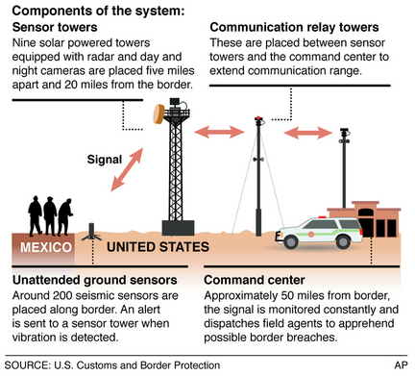
Notes:
Original source from the Associated Press
Picture from: http://www.cleveland.com/nation/index.ssf/2010/02/border_fence_plagued_by_glitch.html

Slide 17
Security Considerations
Certificate Authority (CA) alternative
CA server may not be accessible
What if there’s no way to get the root certificate to validate signatures?
What if root certificate jeopardized?
Peers bump phones on the fly to establish a web of trust
Route data through trusted peers
Each peer signs data as it works its was through the mesh
Receiver validates each signature
Split-packet routing
Split each packet into two and send them over non-overlapping routes
Receiver reconstructs original packet, each half is useless without the other
Don’t request or push an unsigned public key over the air in plain text
Can MITM Diffie-Hellmen key exchange without proper authentication
Notes:
Serval Mesh Data Protocol (MDP) known-issue, currently being addressed
Diffie-Hellmen should be performed over private channel.
Private channel requires trusted wired connection or pre-existing encryption mechanism

Slide 18
Architecture
Map App.
P2P Chat App.
Other App.
Java Networking Interface
TCP Socket
UDP Socket
Global Handset Proxy
Reliable Transmission Layer
Security Manager
Session Manager
MANET Service
Network Configuration
Manual Routing Protocol Selection
Automated Routing Protocol Selection
Modular MANET Routing Protocol Framework
Proactive Routing Protocol Manager
Reactive Routing Protocol Manager
OLSR
Protocol 2
Protocol 3
DSR
Protocol 2
Protocol 3
Linux Kernel Routing

Slide 19
Data Flow
Hello
P2P Chat App.
P2P Chat App.
Java Networking Interface
Java Networking Interface
Transparent Backend
Global Handset Proxy
Global Handset Proxy
Global Handset Proxy
Reliable Transmission Layer
Reliable Transmission Layer
Reliable Transmission Layer
MANET Routing Protocol
MANET Routing Protocol
MANET Routing Protocol
[determine route]
[update network topology / determine route]
[update network topology]
Source Node
Relay Node
Destination Node

Slide 20
Ad-Hoc Mode on Android Hardware
Leveraged Wi-Fi Tether for Root Users app.
Edify script for setting up ad-hoc mode using cross-compiled iwconfig
Some phone wifi drivers don’t support ad-hoc mode
Wi-Fi Tether app. switched to using softAP
softAP: software enabled portable wireless access point
Needed to compile Wireless Extensions support into kernel
Compiled vendor open source software
Dumped zImage and drivers to AnyKernel tree
Flashed using ClockworkMod Recovery

Slide 21
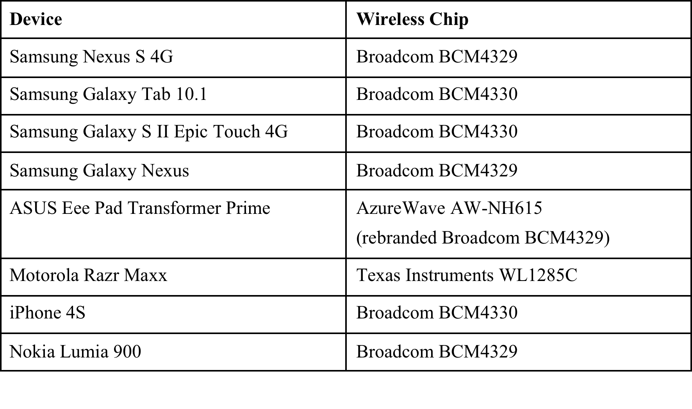
Ad-Hoc Mode on Android Hardware
Easy to flip Broadcom chips into ad-hoc mode
Notes:
Wireless mode: Ad-Hoc, Managed (client), Master (AP), Repeater, Secondary, Monitor, Promiscuous (like Monitor but only for associated networks)

Slide 22
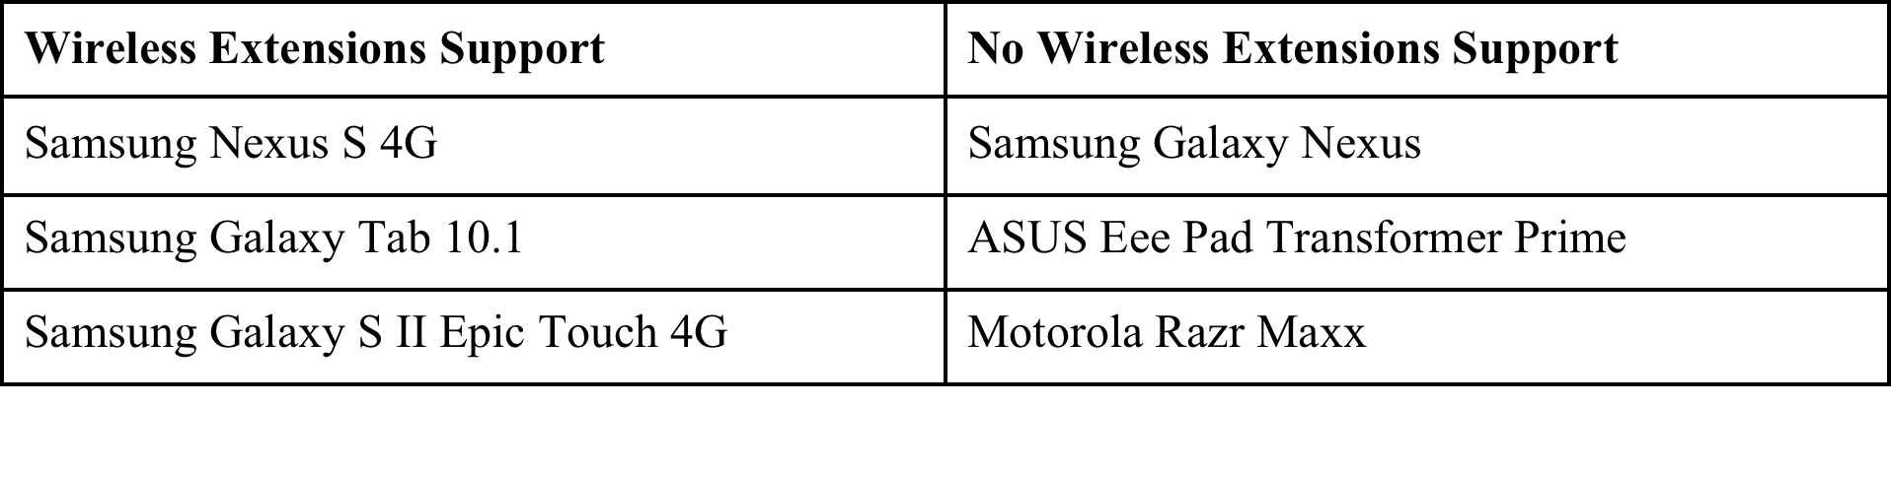
Ad-Hoc Mode on Android Hardware
Currently require Wireless Extensions support
Ad-hoc mode support disabled in some kernels
Add NL80211_IFTYPE_ADHOC back into supported interface modes list
Notes:
/drivers/net/wireless/bcmdhd/wl_cfg80211.c

Slide 23
Implementation Details
Android apps and services (Java language)
MANET Manager, MANET Service, MANET Logger, MANET Visualizer
Native code (C language)
OLSR daemon, P2P VOIP daemon, netfilter hook, Linux utilities
Unique IP address assignment without DHCP
IPv6 link-local addressing based on network adapter MAC address
Connect to existing infrastructure
Gateway device masquerades connection for devices within mesh
Devices within mesh are NATed behind gateway on a subnet
VPN through gateway using PPTP
Notes:
NAT: Network Area Translation
The Point-to-Point Tunneling Protocol (PPTP) is a method for implementing virtual private networks. PPTP uses a control channel over TCP and a GRE tunnel operating to encapsulate PPP packets.
Many different Mobile phones with Android as operating system support PPTP as well.
Android devices filter out UDP broadcasts when the screen is off
WifiManager.WifiLock doesn’t help
Set dhd_pkt_filter_enabled=0 when loading wifi kernel module

Slide 24
Root vs. Non-Root
Root required
Need root to modify iptables / routing tables
Need root to configure wireless driver and put phone in ad-hoc mode
Potential security risk for non-technical users
Root benefits
Transparent proxy handles all outgoing / incoming data
Existing apps work over mesh without modification
Easier to flip in and out of ad-hoc mode without affecting running apps
Potentially automate network scanning (cell, wireless AP, ad-hoc)
Non-root alternative
P2P connection over Bluetooth, Wi-Fi redirect, or client and softAP setup
Apps send data to mesh daemon running on device via SPAN API
SPAN API provides access to peer list, routes, keys, etc.

Slide 25
Range Considerations
Range tests
Frequency: 2.412 GHz
Transmission power: 32 dBm
Galaxy S II Epic Touch 4G and Galaxy Nexus
Approx. 100-170 ft. range down long narrow indoor hallway
Approx. 100-150 ft. line of sight range outdoors in wide open area
Qualcomm’s LTE Direct (previously FlashLinq) part of LTE Release 12
Becoming standardized by the 3GPP standards body
Release 12 should be approved by 2015
OLSR P2P routing protocol
Line of sight connections up to 500m (1640 ft.)
Notes:
dBm is an abbreviation for the power ratio in decibels (dB) of the measured power referenced to one milliwatt (mW)
LTE: Long Term Evolution
ASUS Transformer Prime
Approx. 90 ft. line of sight range outdoors in wide open area
Metal case interferes with transmission and reception

Slide 26
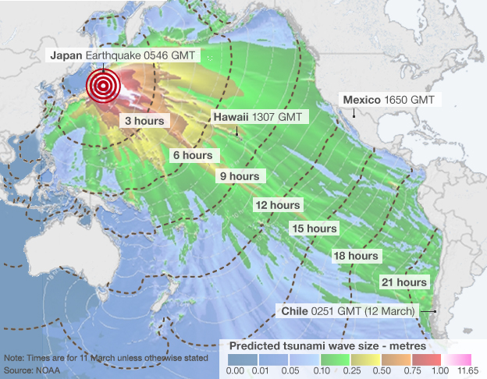
Delay-Tolerant Networking
If intended recipient of an urgent message is not currently reachable, broadcast message to all peers
Peers hang onto message and serendipitously pass it on to new peers
Eventually the message will reach the intended recipient
Peers transparently become couriers of data
Leverage highly mobile nature of ad-hoc networks
Quickly spread word disasters starting from the epicenter and propagate outward
“Right-time” information
Notification messages can be limited to a georadius or destined for a geolocation
Notes:
Set TTL for broadcasts

Slide 27
Proactive vs. Reactive Protocols
Proactive protocols
Daemons run autonomously in user space
Periodically broadcast “hello” and plan new routes
Routes available when you need them
OLSR, BATMAN, etc.
Reactive protocols
Lazily plan routes as needed
Initial communication between peers takes longer
Less processing and CPU usage
Less network congestion
Dynamic Source Routing (DSR), Ad-hoc On-Demand Distance Vector (AODV) routing, etc.
Notes:
DSR: Dynamic Source Routing
AODV: Ad-hoc On-Demand Distance Vector routing

Slide 28
Sensory Intelligence
Battery
Don’t send packets to devices going dead
Send more packets to devices plugged in
GPS
Form routes to devices closer to you
Form routes to devices that don’t move often
Accelerometer
Don’t send packets to devices in motion
Predict device movement, direct packets to devices along movement vectors
Develop intelligent routing protocols
Consider sensor data, mesh stability and history, node density, etc.
Use AI to fine-tune mesh over time, develop hybrid protocols

Slide 29
Strategic Fallback Security Model
Strategy 1: Use X.509 certs assigned by CA
Individual’s public key, private key, and cert get loaded on their device
Each device loaded with the CA root key for X.509 cert signature validation
Peers exchange signed X.509 certs via bump or over the air
Peers use asymmetric encryption over a P2P VPN
Strategy 2: Use self-generated public / private keys
Key pair is generated for each device as part of the SPAN first run process
Peers exchange public keys by physically bumping phones
Peers use asymmetric encryption over a P2P VPN
Strategy 3: Use common symmetric key
One symmetric shared by all users of the mesh as part of the configuration file loaded into SPAN
All routing protocol communications encrypted using symmetric key
Peers use symmetric encryption, other peers can decrypt
Notes:
Attempt to employ strategies in order until options exhausted
TLS: Transport Layer Security
TLS uses public/private key encryption to share a symmetric session key used to encrypt session data.
This helps improve performance and efficiency since symmetric key encryption takes less cycles than asymmetric encryption.

Slide 30
Strategic Fallback Security Model
Users aware of strategy employed when communicating with peers
Strategy 1 and Strategy 2 classified as “high” or “true” security
Strategy 3 classified as “low” or “default” security and
Should not be used for sharing confidential information
Option to limit P2P communications to “high” security (“Trusted Mode”)
If the symmetric key is compromised
User-initiated broadcast propagated out over the network
Upon reception, user is notified and the device automatically reverts to “Trusted Mode”
User can change mode if desired

Slide 31
Operational Support
Major League Baseball All Star Game, July 10 2012
Provided operational support to the Kansas City Police Dept.
Worked with Kansas City Terrorism Early Warning Group
Officers patrolled parking lots around Royals Kaufman Stadium in Gators
Provided with Galaxy Nexus phones running SPAN and Beacon IC.NET app. for reporting GPS position and creating situational reports
ASUS Transformer Prime gateway connected mesh to Persistent Systems Wave Relay equipment long-distance radio equipment
Data piped from mesh to command center server across the road
Provided COP to authorities
Phone density …

Slide 32
Operational Support
Notes:
Fellowship of Christian Athletes
Royals Kaufman Stadium
Chiefs Arrowhead Stadium

Slide 33
Operational Support

Slide 34
Future Work
Applications
VOIP connection to Asterisk server
Torrent protocol to RAID data across devices
Distribute threads and tasks across cloud of unused processors
Delay-tolerant networking
Platform support
iOS, Windows 8
Leverage LTE Direct
Consider integrating with CyanogenMod custom Android ROM
Sponsor outreach
Notes:
RAID: Redundant Array of Independent Disks
SETI@home: Search for Extra-Terrestrial Intelligence
Folding@home

Slide 35
Questions?

Slide 36
Backup

Slide 37
Security Considerations
Don’t request or push an unsigned public key over the air in plain text
Can MITM Diffie-Hellmen key exchange without proper authentication
Should be performed over private channel
PK_{B} ?
PK_{A} ?
PK_{B} ?
PK_{A} ?
Peer A
PK_{Y}
Peer B
Peer A
PK_{Z}
Peer B
Peer C
Peer C
{X₁}_{PK(Y)}
{X₁}_{PK(B)}
{X₂}_{PK(A)}
{X₂}_{PK(Z)}
Peer A
Peer C
Peer B

Slide 38
Routing
D
D
A
B
A
B
C
C
Route to
1-hop neighbor
Route to 2-hop neighbor
Notes:
Topology

Slide 39
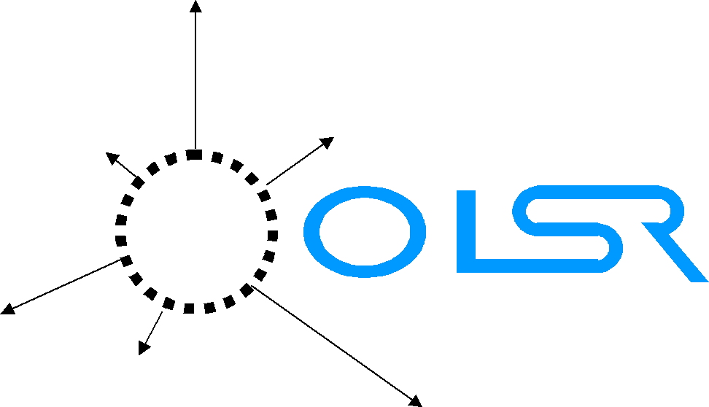
OLSR
Optimized Link State Routing Protocol (2003)
Link-state protocol
Nodes know who they can talk to
Each node determines entire route to every other node
Proactive
Routes periodically planned in advance
Kernel-level routing table modified on-the-fly
Dijkstra Open Shortest Path First algorithm
Layer 3 in OSI stack

Slide 40
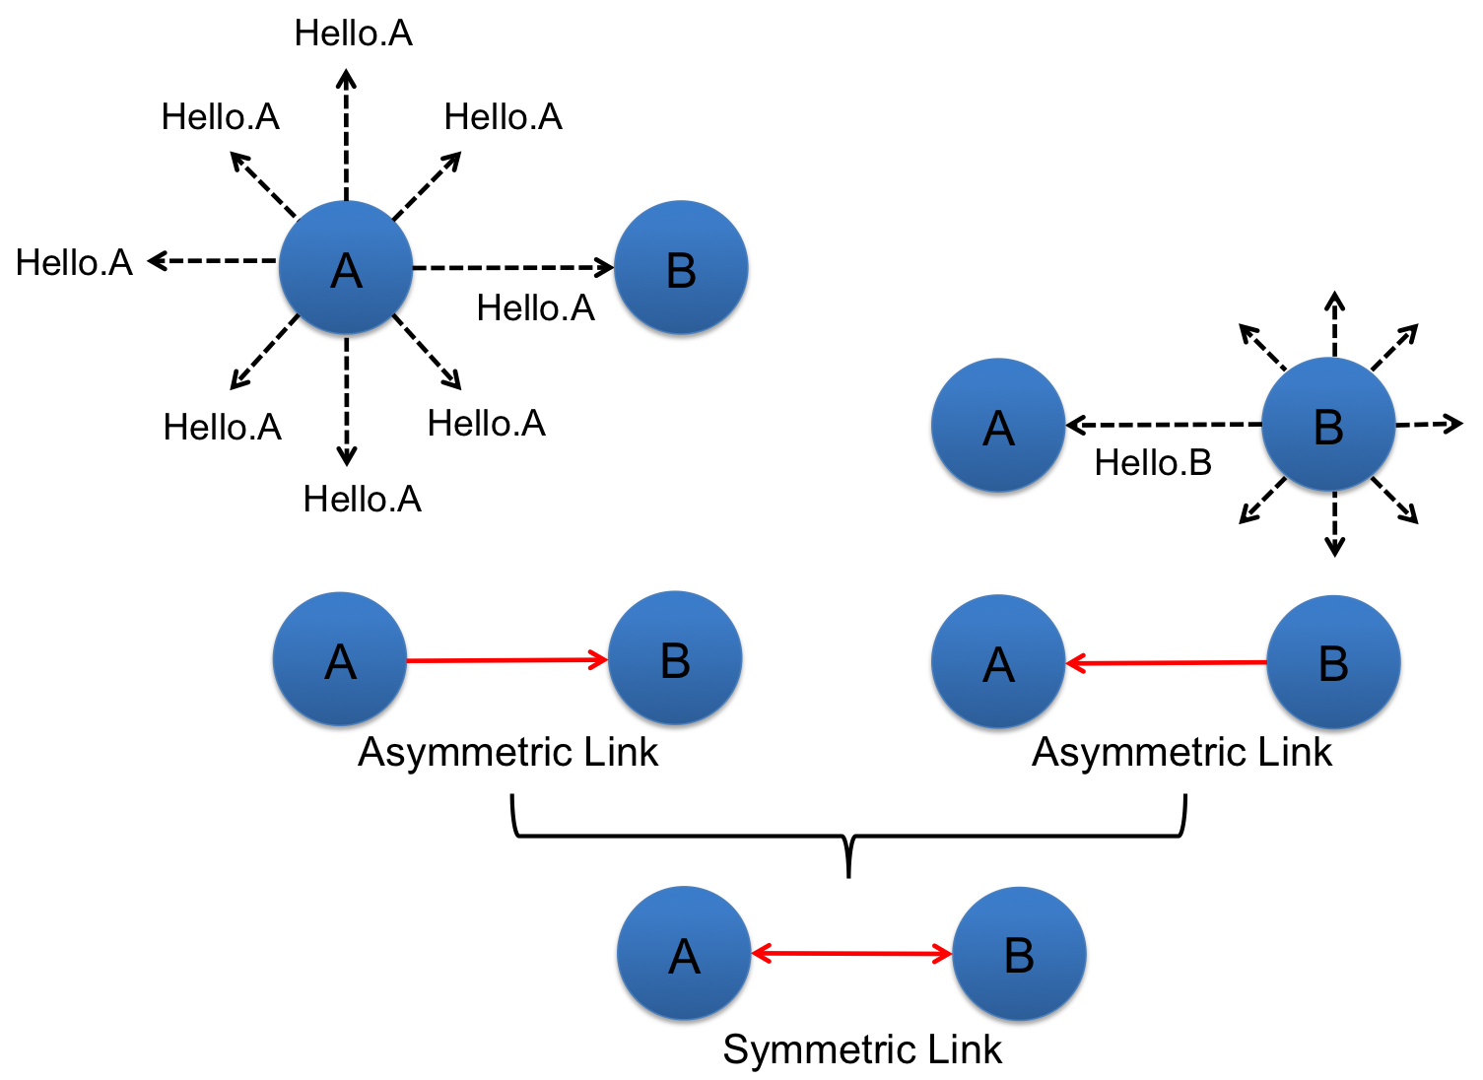
OLSR: Find 1-hop Neighbors
40
Notes:
Hello TTL=2

Slide 41
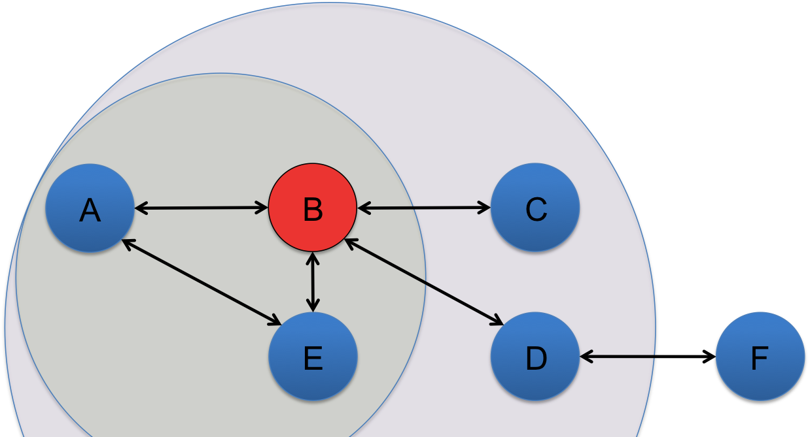
OLSR: Multi-Point Relay
A selects B as Multi-Point Relay (MPR)
All 2-hop nodes reachable through B
All > 1-hop routes from A will go through B
41
Notes:
Hello TTL=2
Assumes B and C are symmetric neighbors
Global topology info is > 2 hops away
MPRs are not always chosen if network is small

Slide 42
OLSR
Pros
Better than everyone sharing everything
Topology info dumps only between MPRs
Incremental improvements
Cons
MPRs are throughput choke points
Entire routes planned in advance, but next hop uses its own route
Main developers behind OLSR came up with BATMAN
Address circular routing, network congestion, and performance issues
OLSR-NG (Next Generation) fixed fisheye feature (~2008)
Performs much better than before with less network congestion
Precise view of close neighborhood, approximate view of farther nodes

Slide 43

BATMAN
Better Approach to Mobile Ad-hoc Networking (2006)
Decentralize: No single point has all the data
No MPRs
Each node sends out originator messages: “I exist”
Every other node keeps track of number of hops an originator message takes to reach them
Simplify: Only plan first step in route
Direct packets along route with lowest originator message hop count
OLSR still the most popular
BATMAN gaining traction
Notes:
Layer 2 (ethernet) implementation: batman-adv

Slide 44


Security Considerations
Serval Mesh Data Protocol (MDP)
Each device assigned random IPv4 address
Each device generates 256-bit ECC key pairs
All outgoing messages are broadcast and contain multiple payloads
Payloads may be destined for different peers
Each payload contains sender, destination, and next hop public key
Public key used to filter and route data between Serval daemons
Essentially a custom network stack
There Is No Cabal (tinc)
”tinc is a self-routing, mesh networking protocol, used for compressed, encrypted, virtual private networks”
P2P VPN routing daemon using X.509 certificates
Android port
Notes:
ECC: Elliptic Curve Cryptography

Slide 45

P2P VPN Data Flow
“Can you keep a Secret?”
P2P Chat App.
P2P Chat App.
DATA (to: 2.2.2.103)
DATA (from: 2.2.2.101)
Mobile OS TCP Socket
Mobile OS TCP Socket
TCP
TCP
tinc VPN Tunnel (tun0)
2.2.2.101
Transparent Backend
tinc VPN Tunnel (tun0)
2.2.2.103
UDP
UDP
UDP
UDP
MANET Wi-Fi (wlan0)
192.168.11.101
MANET Wi-Fi (wlan0)
192.168.11.102
MANET Wi-Fi (wlan0)
192.168.11.103
Source Node
Peer 101
Relay Node
Peer 102
Destination Node
Peer 103
Notes:
tinc runs as a daemon process that opens and manages the tun virtual network device.
Packets are routed across the mesh based on each Node’s routing table entries.
The proactive routing protocol runs as a daemon process and updates the routing table on each device.

Slide 46
Ad-Hoc Mode on iOS Hardware
iOS Devices have a history of using Broadcom chips similar to those already supported by SPAN Android devices

Slide 47
Ad-Hoc Mode on iOS Hardware
Apple doesn’t expose a public framework method of placing an iOS wireless device in to ad-hoc mode
Indicates that jailbreaking (root) is likely necessary
IPConfiguration.bundle private framework potentially exposes configuring the device mode
Cydia Store
Provides the capability to distribute applications outside of the Apple App Store to jailbroken devices
Could be leveraged to distribute SPAN
Apps on Cydia that are configuring the Wireless Device beyond the public framework capabilities
MyWi and WiFiFoFum access capabilities beyond the public framework
Modify firmware to enable ad-hoc mode?

Slide 48

Freifunk
German for "Free radio”
Non-commercial open grassroots initiative to support free open radio networks in Germany
Offers specialized OpenWrt firmware
Routing based on OLSR or BATMAN
Freifunk Berlin has 500+ nodes
http://berlin.freifunk.net/
http://wiki.freifunk.net/
Notes:
WRT: Linksys WRT54G series (including the WRT54GL and WRT54GS)

Slide 49

Serval
Also known as batphone
Android ad-hoc network framework
Implemented features
P2P VOIP calls over mesh
MeshMS, free mesh-based SMS
Features under development
Serval Rhizome, distributed mesh-based data distribution platform
Serval Maps, mesh-based mapping application
Serval Morse, distributed micro-blogging service
Custom Mesh Data Protocol (MDP)
http://www.servalproject.org/

